Slide 1
Estimation of brain microstructural parameters with diffusion MRI
Abrar Faiyaz
Department of Electrical and Computer Engineering
Notes:
Hi everyone, I’m going to talk on my work regarding single shell NODDI microparameter reconstruction using deep learning.

Slide 2
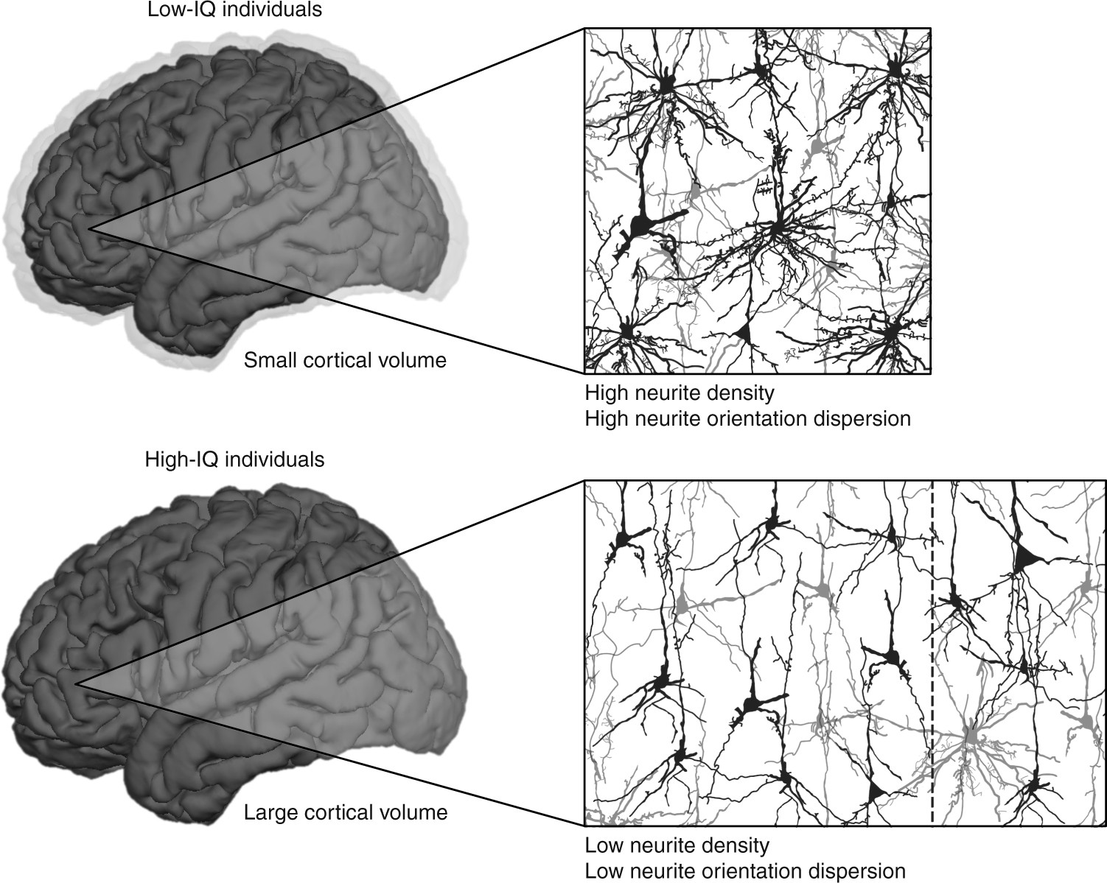
Introduction
Neurites are the structural units of the brain. Histological analysis of neurite physiology has helped us understand
Brain development¹ (Conel, 1939)
Brian Aging² (Jacobs et al., 1997)
Functional behavior³ (Jacobs et al., 2001)
Pathological changes⁴ (Fiala et al ., 2002)
Magnetic resonance imaging is non-invasive and can quantify changes in mm scale with T1w, T2w, FLAIR, diffusion MRI.
Example in the right shows how neurite orientation and density can differentiate low and high IQ individuals. (Genç, E 2018, Nature Communications)
Figure 1: Schematic depiction of differences between low-IQ and high-IQ individuals with regard to brain volume, neurite density and orientation dispersio. (Genç, E 2018, Nature Communications)
Advanced mathematical model to get these microstructural parameters works with certain dMRI protocols that pose constraint on clinical MR scans.
Possible MR tools for microstructural abnormality investigation-
Diffusion weighted MRI
fMRI- BOLD,
MRE etc
Notes:
Might look like an MR scan will replace GRE in the future 🤖 … ?
Intellectual performance is likely to benefit from this kind of microstructural architecture since restricting synaptic connections to an efficient minimum facilitates the differentiation of signals from noise while saving network and energy resources
# Conel looked at the

Slide 3
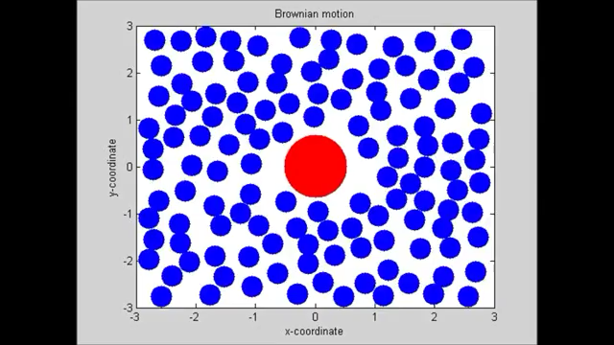
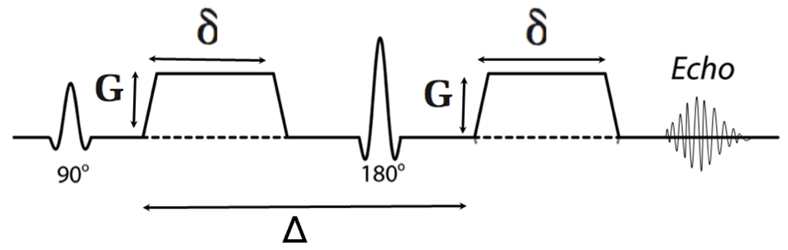
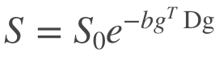
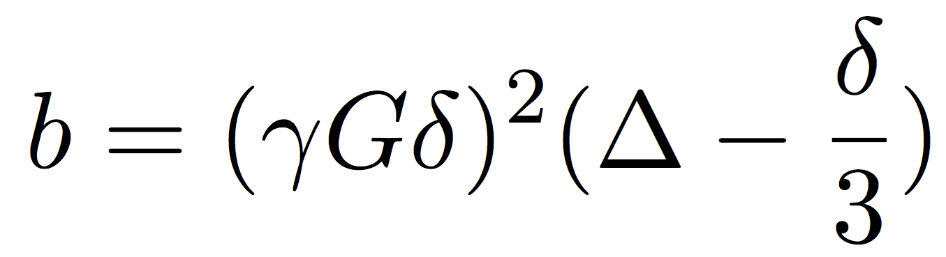
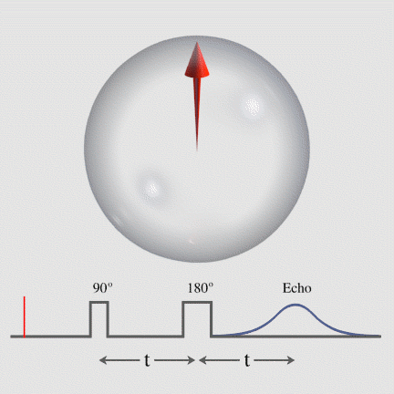
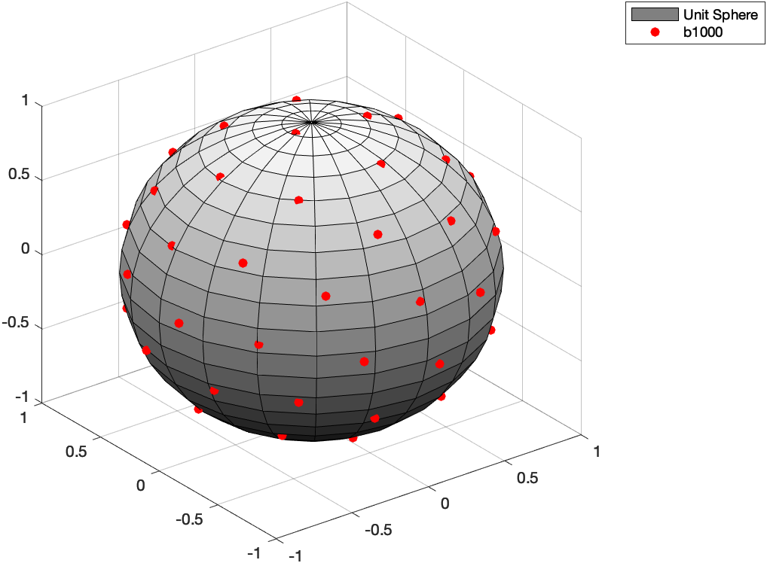
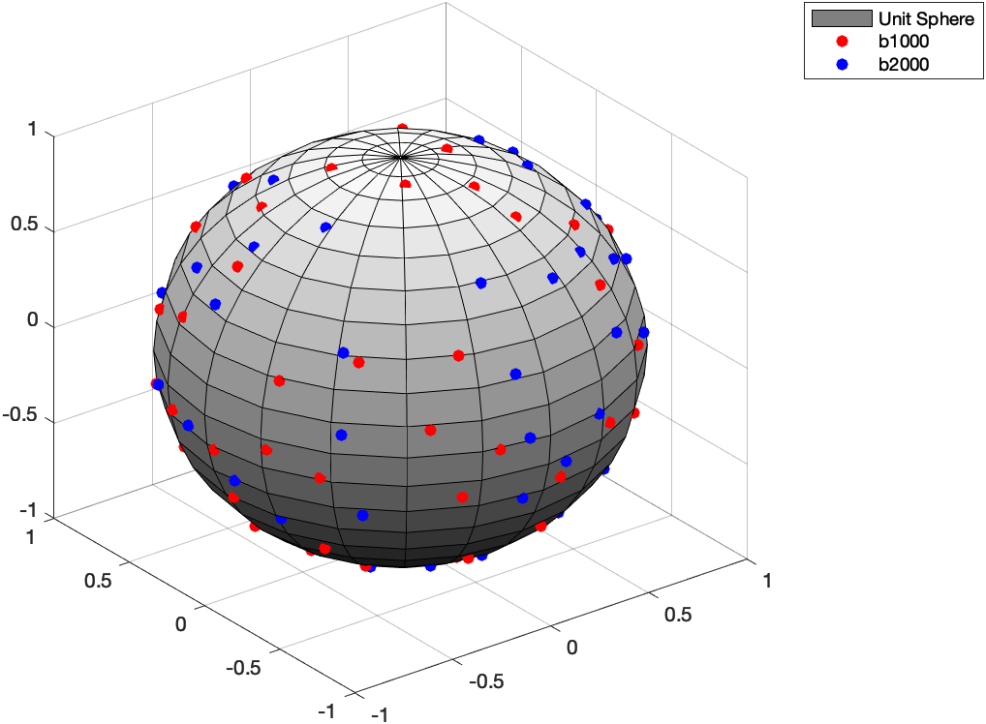
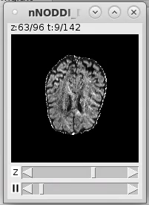
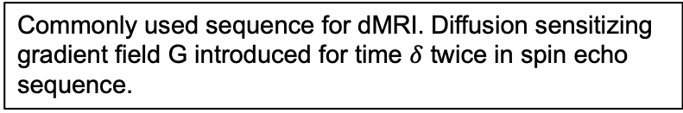
Diffusion MRI
Diffusion in MR: Quantified as the amount of signal loss when diffusion sensitized gradient is applied.
B
Sequence in figure B is repeated with different gradient directions g, to solve for diffusion tensor D
Commonly used sequence for dMRI. Diffusion sensitizing gradient field G introduced for time $δ$ twice in spin echo sequence.
A
C
D
S₀
Net spin in a spin echo sequence
b-vector (g) encoding on unit sphere: (C) cART (D) CSVD
Ref
Notes:
1. In diffusion MRI, the term diffusion is based on the physics that when a gradient is applied the regions of hindered diffusion will result in higher signal and there will be signal loss at the regions of free diffusion.
2. The first figure with blue dots give a representation of water molecules in a restricted region moving with brownian motion.
3. Now we represent the net spin (or the magnetic alignment of that region) in figure A. Here in figure A. we see a common spin echo sequence where Echo is the read MR signal after applying 90* and 180* pulse. The read signal is the signal that we get from the restricted region. So, we can say the spin echo sequence is the common way we quantify signal of a voxel.
Now, the only thing that's left is adding the diffusion gradient to this sequence.
4. At figure B, We apply two same diffusion encoding gradient before and after the 180* pulse and the Gradient applied are of opposite polarity. So, effect of opposite gradients cancel out for a "spin that doesn’t move" and signal over there is higher. Opposite happens for the spins that moves.
Also the higher the number of repetation in different direction, the better diffusion analysis. And the minimum has to be 6 acquisions to be able to solve this (5) equation s=s0exp(-bgDg). B-value is defined with this equation and is directly proportional to the gradient strength and time delay. Gamma is the gyromagnetic ratio.
6. On these unit spheres, b-vector or directions of the gradients is shown for cART and CSVD study. This is the small g in the equation. Lastly, a slice for different diffusion direction is shown for ongoing CSVD study
###Any free system with a constant gyromagnetic ratio, such as a rigid system of charges, a nucleus, or an electron, when placed in an external magnetic field B (measured in teslas) that is not aligned with its magnetic moment, will precess at a frequency f (measured in hertz), that is proportional to the external field:, f = (gyromag ratio/ 2pi) * B

Slide 4
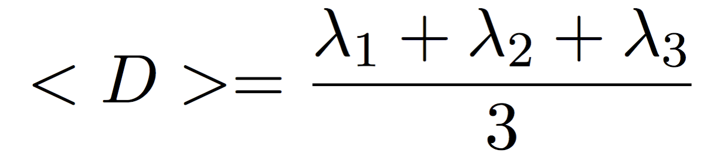
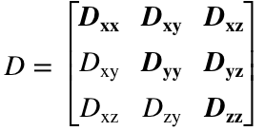
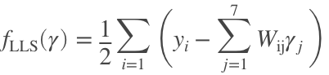
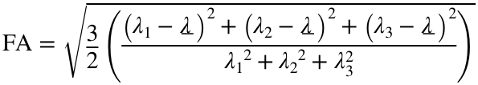
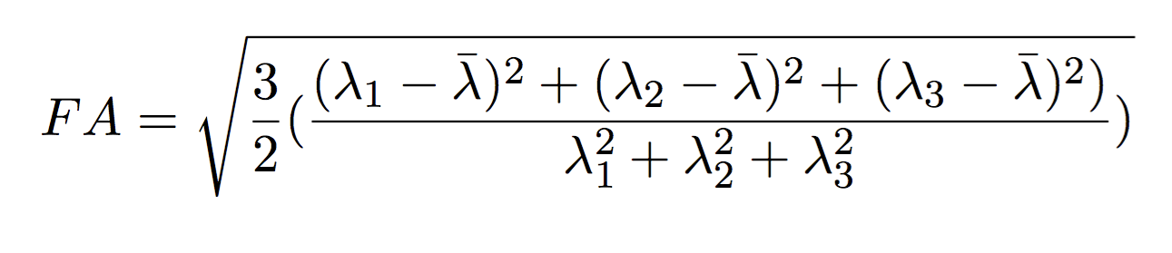
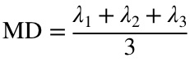
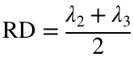
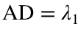
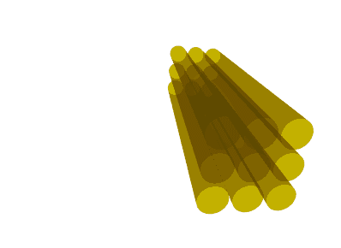
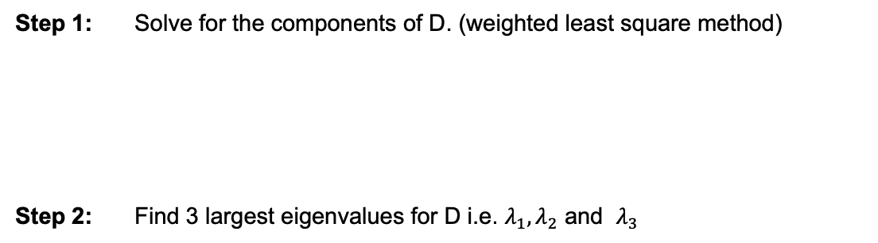
Diffusion Tensor Imaging (DTI) ^{(Koay, C. G. et al 2006)}
Step 1: Solve for the components of D. (weighted least square method)
Step 2: Find 3 largest eigenvalues for D i.e. $λ_{1},λ_{2}$ and $λ_{3}$
Step 3: Calculate FA, MD, RD, AD.
Normalized variance of largest 3 eigenvalues (Fractional Anisotropy),
,
Mean Diffusivity
Radial Diffusivity
Axial Diffusivity
Diameter of axon+ myelin ~0.0005mm
# of axon in white matter
~4000 in (2x2x2mm)
Notes:
In diffusion MRI, the first step is to calculate the components of D, and to do that we need to solve the objective function you are seeing in step 1, where yi is log of S0 and W_ij is constructed based on the power component of the exponential. And gamma_j is the components of D arranged in such a way that the first equation is satisfied.
After identifying the gamma that is all the D components, we calculate the highest eigenvalue-eigenvector pairs and use the eigenvalues to calculate FA,MD,RD and AD.

Slide 5
DTI scalars in pathological
DTI SCALARs | FA (normalized variance of the eigenvalues) | MD (λ₁+λ₂+λ₃)/3 | AD λ₁ | RD (λ₂+λ₃)/2
 | FA is a summary measure of microstructural integrity. While FA is highly sensitive to microstructural changes, it is less specific to the type of change. | MD is an inverse measure of the membrane density, is very similar for both GM and WM and higher for CSF. MD is sensitive to cellularity, edema, and necrosis. | AD tends to be variable in WM changes and pathology. In axonal injury AD decreases. The ADs of WM tracts have been reported to increase with brain maturation. | RD increases in WM with de- or dys-myelination. Changes in the axonal diameters or density may also influence RD.
Gray Matter | ↓ | − | ↓ | ↑
White Matter | ↑ | − | ↑ | ↓
CSF | ↓ | ↑ | ↑ | ↑
High myelination | ↑ | ↓ | − | ↓
Dense axonal packing | ↑ | ↓ | − | ↓
WM Maturation | ↑ | ↓ | ↑ | ↓
Axonal degeneration | ↓ | ↑ | ↓ | ↑
Demyelination | ↓ | ↑ | − | ↑
Low SNR | ↓ | ↑ | ↓ | −
Notes:
These dti scalars are directly related with changing brain macrostructural integrity. We see from different studies, how change in different dti scalars have been related with high myelination, dense axonal packing, WM maturation, Axonal degradation, demylination. Previous literatures report this on Alzheimers, Parkinsons etc neurocognitive diseases.
Table:
https://thewinnower.com/papers/3524-dti-scalars-fa-md-ad-rd-how-do-they-relate-to-brain-structure

Slide 6
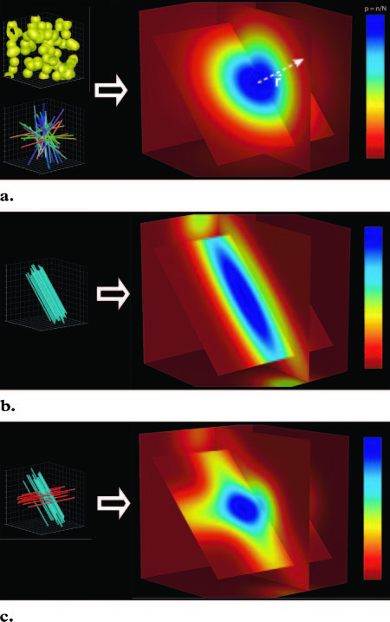
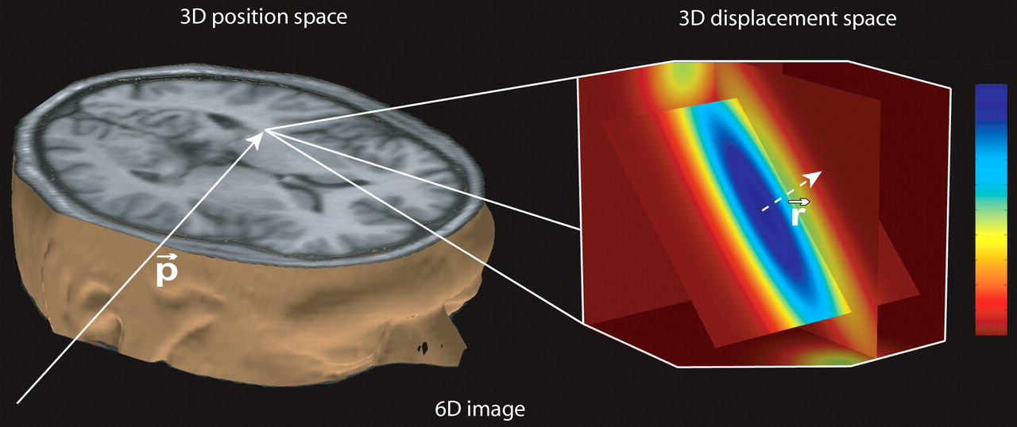
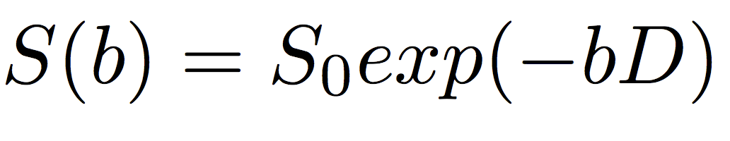
DTI : Limitations^{(Hagman, P. et al, 2006)}
Possible configuration and their simulated displacement
Ellipsoid model with the eigenvalues cannot distinguish
- crossing fiber and isotropic configuration (a,c)
- standing water compartments.
- complex fiber orientations.
- intra/extracellular differentiations.
Figure 1. Left part of diagram shows that standard imaging methods provide one value (gray level) for every 3D position p. That value or gray level may code for the linear x-ray attenuation coefficient at CT or for the relative signal intensity at MR imaging. Right part of diagram shows that in diffusion imaging every 3D position p (voxel) is associated not with a gray level but with a 3D image that encodes the molecular displacement distribution in that voxel. The value measured at the coordinates p,r—ƒ(p,r)—indicates the proportion of molecules in the voxel that have moved the given distance r.
Notes:
The DTI ellipsoid model with the eigenvalues cannot distinguish crossing fiber voxel with actual isotropic voxels. Here all the 4 images shown are simulations of displacement profile using some fiber orientation and specific diffusion tensor. In the simulation a and c it is clear that one is crossing fiber and another is stationary water probably CSF in the brain. But when we reconstruct our tensors with 3 eigenvalues that’s not possible to understand in general diffusion model. Secondly, complex fiber orientations cannot be captured with this model and the intracellular and extracellular information cannot be distinguished by this model.
https://doi.org/10.1148/rg.26si065510

Slide 7
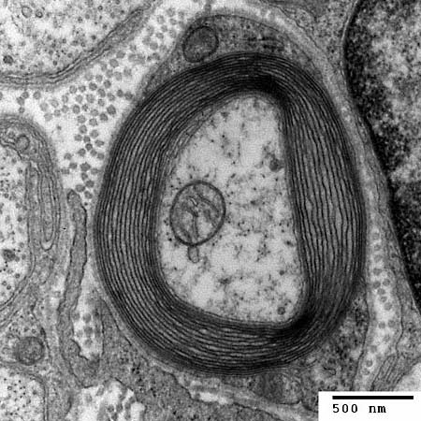
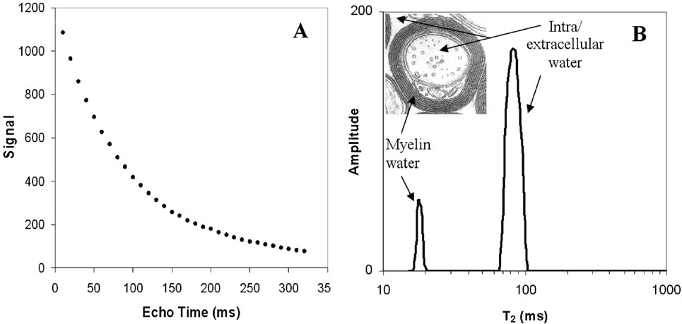
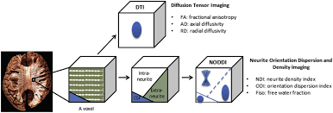
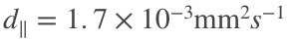
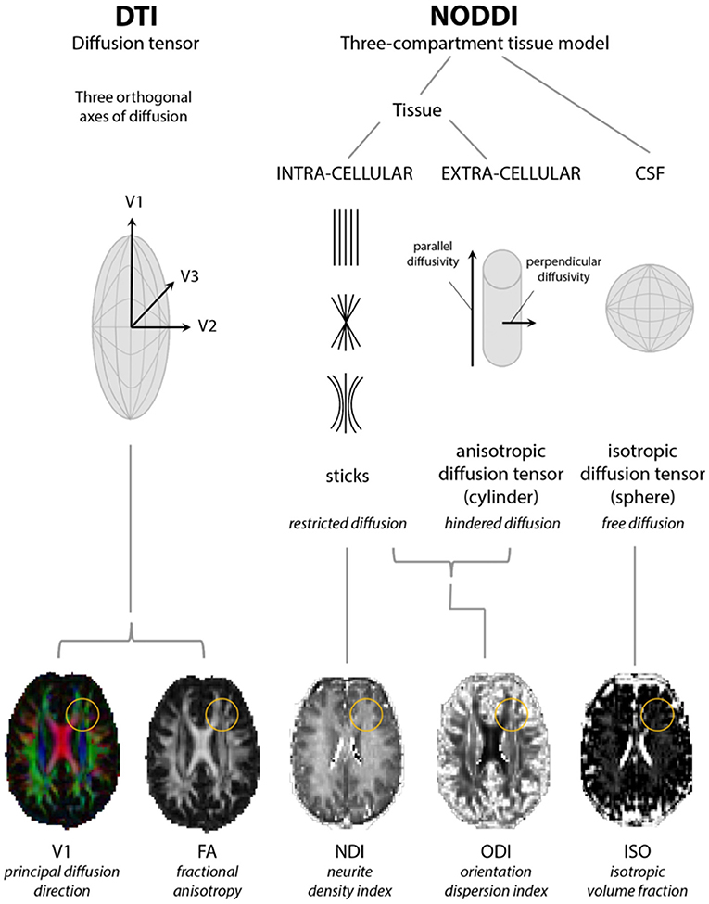
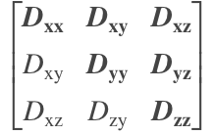
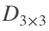
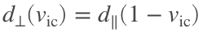
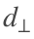
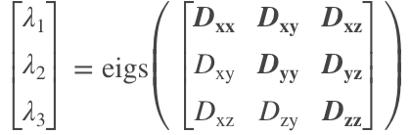

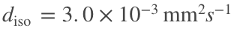
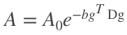
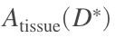
Hypothesis behind DTI and NODDI
(e)
Extracellular water
(a)
(b)
Myelin water
Intracellular water
Figure: Image under Transmission electron microscopy
Diameter of axon+ myelin ~0.5 µm
Around ~4000 in (2x2x2mm) voxel
(c)
NODDI
(d)
DTI
Notes:
In this slide you'll understand the distinction between DTI and NODDI. Before I jump to that, let’s see a microscopic environment inside the brain in figure e. This is a typical image that can be seen under transmission electron microscope. You can see three different compartments that holds H+ ions here. Extracellular, intracellular and myelin water, the signal can also be free water inside the same voxel. Although myelin water is not relevant here, you can see that we can separate out the myelin water signal at lower TE but intracellular and extracellular signal remains combined when TE is around 100ms (figure B).
In summary,
When we get a signal from a voxel of 2mm resolution, that signal has contributions from isotropic, extracellular water and intracellular water. Generally diameter of an axon is around 0.5 micrometer, So in one voxel there’s a lot of configuration possibility of fibers and free water.
So, let’s see what DTI does to understand these configurations. Per voxel, a diffusion tensor is assumed which is solved. And this tensor is represented with their highest 3 eigenvalues. That visualizes the diffusion on an ellipsoid formed with those eigenvalues.
But NODDI changes the physics of the problem. We consider each signal to be a combination of 3 compartment with different diffusion coefficient. Parallel, hindered and isotropic diffusion per voxel. To account for what is the amount of contribution, a probability term volume fraction is given to each generated signal from individual compartment.
##########
In figure A we see T2 decay curve and figure B shows T2 distribution from white matter. So it actually depends on the selection of the echo time to separate myelin water signal and intra-extra cellular signal. When Echo time is around 100ms, we can see that the intracellular and extracellular signals are merged. Here’s where NODDI model comes in and setup a probabilistic model that can solve for intracellular and extracellular water contribution.
(A) T2 decay curve and (B) T2 distribution from human white matter. Inset in (B) shows a cross-section through an axon with the locations of intra/extracellular water and myelin water.
So, what we see here signal contribution for intracellular and extracellular cases is merged.
Images:
https://www.slideserve.com/kaylee/schwann-cells
https://www.britannica.com/science/myelin
Laule, C., Vavasour, I.M., Kolind, S.H. et al. Magnetic resonance imaging of myelin. Neurotherapeutics 4, 460–484 (2007). https://doi.org/10.1016/j.nurt.2007.05.004

Slide 8
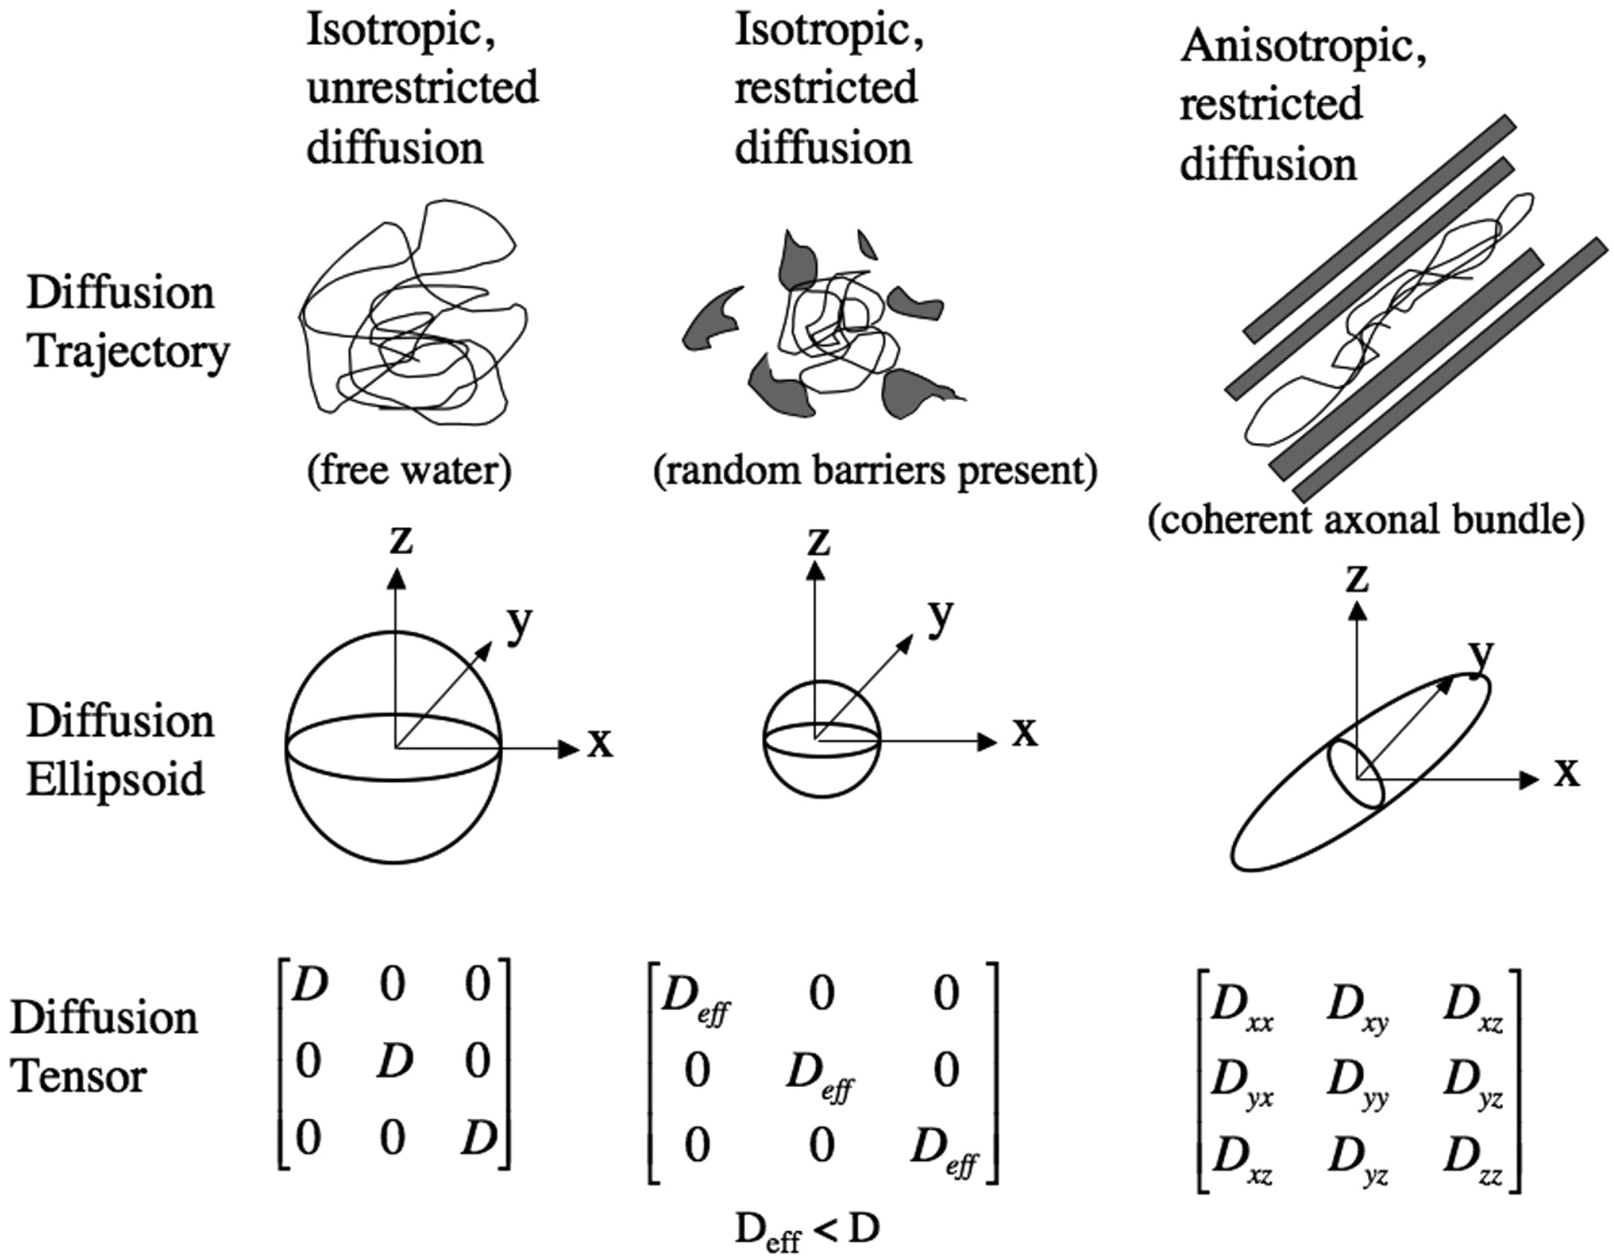

The diffusion ellipsoids and tensors for isotropic unrestricted diffusion, isotropic restricted diffusion, and anisotropic restricted diffusion are shown.
NODDI
Complex configurations
DTI
Simple representation
of complex configurations
P. Mukherjee et al. AJNR Am J Neuroradiol 2008;29:632-641
©2008 by American Society of Neuroradiology
Notes:
So, we already saw there can be many possible tissue configurations in a single voxel. And you can actually quantify them based on the set of components in the D matrix.
Simply said, NODDI is capable of explaining more complex configurations along with the simple ones. Where DTI represents simple or complex configuration in simple ellipsoids.
###
What I mean is that, # show images
The diffusion ellipsoids and tensors for isotropic unrestricted diffusion, isotropic restricted diffusion, and anisotropic restricted diffusion are shown.
Diffusiion trajectory incase of free water, when random barriers present and when axonal bundles are coherent are shown here.

Slide 9
In simpler terms,
Intra-Cellular Volume fraction (ICVF or v_{ic})
– represents fiber/axon density.
– also termed as Neurite Density Index (NDI).
– Signal contribution of fibrous compartment.
Orientation Dispersion Index (ODI) – denotes the geometry of the fibers.
Isotropic Volume fraction (ISO) – denotes the standing water content in the voxel
Notes:
Here, I have shown examples of the DTI scalar and NODDI microstructure maps.

Slide 10
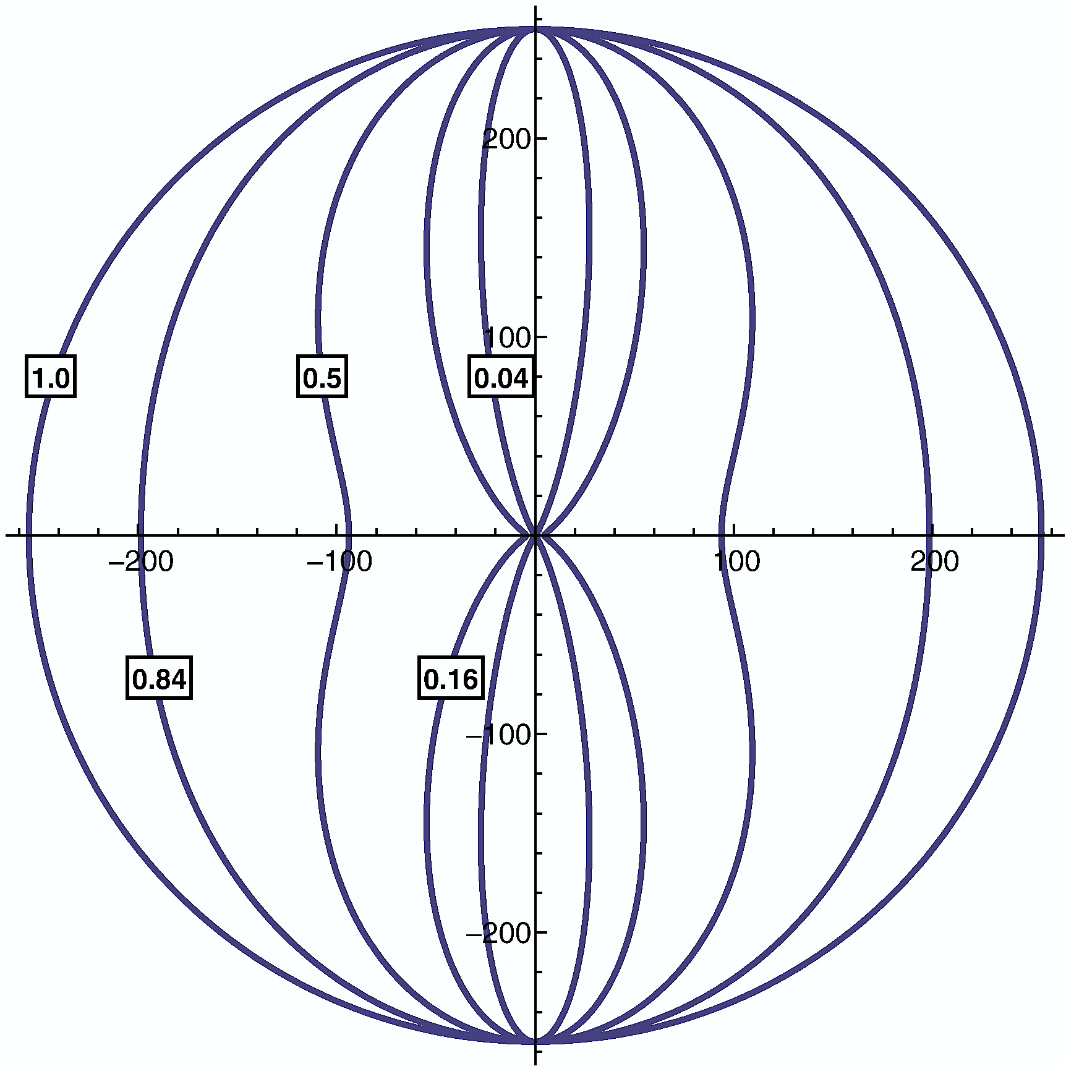
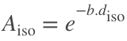
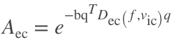
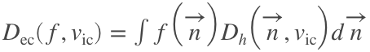
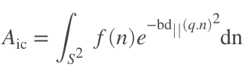
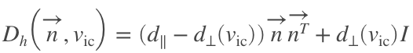
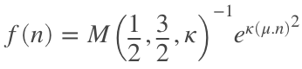
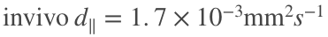
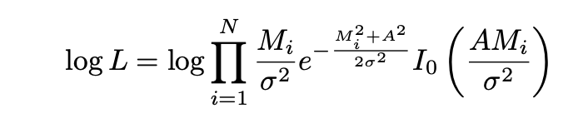
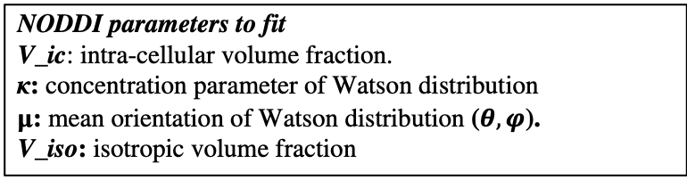
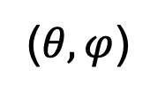
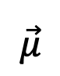
Background: NODDI ^{(Zhang,2011,2012)}
$$\vec{μ}$$
($θ,φ$)
Standing water signal model
Extracellular signal model
Intracellular signal model
Figure 1. Illustration of a set of Watson distributions with the same mean orientation but different orientation dispersion index: OD ∈ {0.04, 0.16, 0.5, 0.84, 1.0}.
Maximum Likelihood estimation for fitting parameters,
(Rician log-likelihood function for measured (M) and generated signal (A))
NODDI parameters to fit
V_ic: intra-cellular volume fraction.
κ: concentration parameter of Watson distribution
μ: mean orientation of Watson distribution ($θ,φ$).
V_iso: isotropic volume fraction
2 slides here . Explain what icvf… terms mean
Where, q and b are the gradient direction and b-value of diffusion-weighting, respectively;
f(n)dn gives the probability of finding sticks along orientation n; gives the signal attenuation due to unhindered diffusion along a stick with intrinsic diffusivity d∥ and orientation n.
Notes:
NODDI model calculates signal A and tries to fit it with measured signal M with maximum likelihood framework with rician loglikelihood function.
I’ll explain how this model generates signals when a protocol is given [a protocol is a set of b-value denoted by b and bvectors denoted by q here].
To characterize the brain tissue, NODDI assumes there are 3 signal contributions.
The simplest signal model comes from the standing water signal and as modelled with the exponential decay with a known diffusion coefficient from the literature.
The second one is the Intracellular signal model. This is the cdf of the probability density function modelled with a confluent hypergeometric function called Watson distribution (illustrated at right). It has a kappa parameter that determines the geometry of the fiber. The cdf is weighted with exponential decay with a constant diffusion coefficient factor for each sampled direction.
The third one is the extracellular signal model and whose diffusion coefficient is related to parallel diffusion coefficient. And the cdf is calculated with the help of an analytical form.
This 3 signals are then weighted with a probabilistic contribution from each compartment termed as volume fraction.
### Possible questions-
Why exponential decay? Because any signal whether it be from extracellular, intracellular or isotropic, with increasing b-value it will decay exponentially. That’s how MR signal from any substance decays
###
Add more slide regarding how they said 1 shelled estimation is not good.

Slide 11
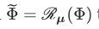









Accelerated Microstructure Imaging via Convex Optimization^{(Daducci et al., 2015)} (AMICO)
Step1: Linearizing the NODDI model in a canonical orientation (z-axis)
ν_{ic} ∈ {0.1, …, 1} (12)
κ ∈ {0, …, 20} (12)
Permute ν_{ic} and κ. calculate A_{ic} for each.
Step2: for every voxel do follows-
Calculate fiber orientation (μ) with DTI fit
Rotate each atom with μ
Solve for
Step3: Calculate microparameters from estimated x.
(a)
(b)
$$N_{m}$$
M1 M2 M3 … N1 N2
q1 q1 q1 … q1 q1
q2 q2 q2 …. q2 q2
. . . . .
. . . . .
X1
X2
X3
.
.
y1
y2
y3
.
.
$N_{d}$= Number of gradients
$N_{m}$= Number of models
$$N_{d}$$
=
x
y
(c)
(d)
Data: Multi-shelled dwi
Notes:
The non-linear fitting in NODDI model makes it computationally bulky that may require powerful computer clusters and computational time very long. Daducci illustrated that the original NODDI reconstruction for a dMRI data with moderate spatial resolution, took around 65 hours on a standard workstation. In order to improve the time complexity, the problem has been reformulated in a dictionary-based framework and Accelerated Microstructure Imaging via Convex Optimization (AMICO) has been proposed . The linearization of the non-linear NODDI problem via AMICO made the fitting four orders of magnitude faster and the estimated microstructure parameters demonstrated to preserve accuracy and precision with correlation above 0.9. This also made a ground for the sparse reconstruction strategies to be utilized with deep learning approaches to solve the NODDI problem. However, this sparse representation of the diffusion signal in AMICO still required higher number of diffusion gradients with multi-shelled protocol as similar to NODDI in order to estimate the microstructural parameters.
The steps taken for this model is Formation of the dictionary at z-axis at the first step, then independently calculating the fiber orientation and rotating the atom based on the fiber orientation for each Phi.
Point to note, The dictionary variable Phi is created manually in AMICO but in deep learning domain this can be made to train.

Slide 12

q-space DL^{(Golkov et al., 2016)}
Training data:
Input: Multi-shelled diffusion weighted images (with varied number of dwis)
Output: v_{ic} , OD
Structure: Multi-Layered Perceptron (3 hidden layers)
v_{ic}
OD
Notes:
MLP Multi layer perceptron with 3 hidden layers showed the potential to reduce the number of gradients with multi-shelled diffusion data in 2016.
Basically, they showed that a simple neural network can reconstruct better than NODDI when number of gradient direction is less than 70 (multishelled).But the error had room for improvement.

Slide 13




MEDN, MEDN+^{(Ye 2017)}
Training data:
Input: Two-shelled dwi data (60 dwi)
Output: Multi-shelled AMICO generated v_{ic}, OD, v_{iso}
Structure based on IHT algorithm¹
IHT algorithm^{(Blumensath et al., 2008)}
Note :
Training time (~160 min) if #{W} ~301
Memory used (~4GB)
Notes:
In 2017, Ye proposed a network with and without 3 by 3 by 3 patch. One is called MEDN and another is MEDN+.
MEDN network reduced the number of gradient directions by further accuracy and precision but training and test data used multi-shelled protocol.
#We investigated IHT theorem referenced in this paper and found the iteration used for the IHT process can be redundant and replaced with a constant stochastic input layer and backpropagation can learn the W and S vector required to learn in the IHT process.

Slide 14

MESC-Net^{(Ye 2019)}
M-LSTM
Training data:
Input: Multi-shell dwi data (36 dwi)
Output: Multi-shelled AMICO generated v_{ic}, OD, v_{iso}
Structure: IHT algorithm + LSTM
IHT algorithm^{(Blumensath et al., 2008)}
Figure: (b) Modified-LSTM structure
Table : Comparison error mean± std
Figure: (a) Microstructure Estimation with Sparse Coding-Network (MESC-Net)
Networks | v_{ic} | v_{iso} | OD
MEDN+ | (3.27 ± 0.2) x10⁻² | (1.90 ± 0.15) x10⁻² | (4.81 ± 0.2) x10⁻²
MESC-Net | (3.16 ± 0.2) x10⁻² | (1.84 ± 0.15) x10⁻² | (4.60 ± 0.17) x10⁻²
Limitation:
Did not converge for single shell data with higher b-value.
Memory (47GB RAM + 330MB GPU memory) intensive
Notes:
Then we see MESC-Net also put forward by Ye, showing that using multishell 36 dwi data, they can further improve the accuracy of the parameter reconstruction. This network's structure is similar to IHT process with a modified LSTM unit. Since LSTM units have a potential to memorize history of signal to generate output it makes sense why accuracy is improved with this type of network.
But this model is highly memory intensive and did not converge for single shell data with higher b-values.

Slide 15

Intracellular volume fraction
Notes:
I’ll not throw all 14 figures here at you to compare which reconstruction is the best.
The way to understand this figure is,
The first row is my proposed model.
The second row is the dictNet prediction of the microstructure.
The third row is the NODDI.
Different columns represent different protocols. And the best result recorded in literature till now is NODDI_Pall (It’s protocol is with 270 directions with 3 different bvals).

Slide 16

Orientation Dispersion Index

Slide 17

Volume fraction of Isotropy

Slide 18







DLpN_P3
NODDI_Pall
I
S
H
(a)
(c)
V_{ic}
ODI
V_{iso}
(b)
(d)
DLpN_P3
NODDI_Pall
Notes:
You might have noticed, it's difficult to compare and contrast 3 different parameters all at once. To resolve that issue we visualize all the 3 generated microparameters in HSV space. Where different color represents different water contribution. Intensity if white means higher OD, dark if lower where OD represents geometry of fiber. And icvf changes the intensity of color.
#
HSV image is like a conditional viewing system. I’m saying conditional because we see Hue and Saturation conditioned on V. What do I mean by that (pointing towards the image) we have 3 components - H,S and V. And V is the conditioning parameter. We replace icvf in the place of V, meaning we will get the Saturation and Hue only if V has a higher value. If V is 0, other components be higher or lower we won’t be able to see that.
Significance of merging 3 parameters is to get pathological changes in microstructure in one image so that it becomes medical modality for radiologists to be able to view it all at once.
###
Simple explanation:
1. Different color represents amount of standing water.
2. Saturation of the color represents ODI (if whitish then fiber, if color more, then crossing fiber regions)
3. Intensity of the color represents darkness or lightness of the color. The more darker the color is lower the icvf.
#Exception only in case of CSF, icvf not dark
###
Make an argument about the bottom (4th) region. That is difficult to interpret when you are only looking at the icvf map. Or even, you are looking at the two maps(icvf and iso) side by side it’s difficult to identify. Now we have devised a new way to visualize three important NODDI microstructural parameters all together. Then show them the hsv image of the original NODDI reconstruction. Then, show what it looks like after we estimate a better icvf map (hsv image of the second image).

Slide 19
Combined 3 parameters in HSV space
Notes:
In this slide you'll see the visual comparison will make more sense.

Slide 20
z=65
z=50
For all WM and GM regions from JHU & HO atlas
Notes:
Here, we see correlation of NODD_Pall vs DLpN protocols column wise and you'll find different parameters accross the rows.
Our result correlation with best possible result from NODDI.
# Make mean +- std (Table)

Slide 21


